Slide 1
Quadratic Functions and Factoring
Algebra 2
Chapter 4
Notes:
Algebra II 4

Slide 2
This Slideshow was developed to accompany the textbook
  Larson Algebra 2
  By Larson, R., Boswell, L., Kanold, T. D., & Stiff, L.
  2011 Holt McDougal
Some examples and diagrams are taken from the textbook.
Slides created by
Richard Wright, Andrews Academy
rwright@andrews.edu

Slide 3

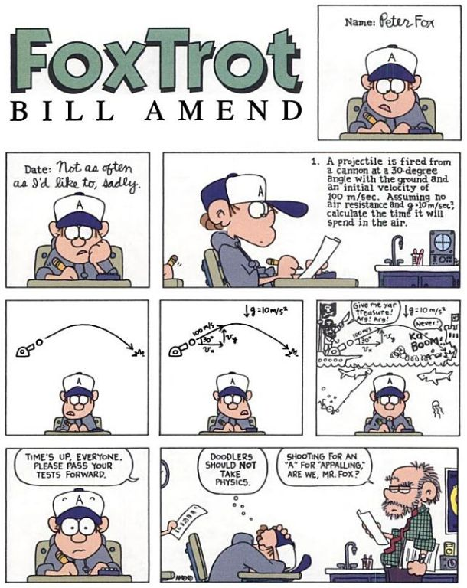
4.1 Graph quadratic Functions in Standard Form
Many physical events can be modeled with quadratic equations such as projectile motion.
The graph of a projectile versus time looks exactly like the path the projectile takes.

Slide 4
4.1 Graph quadratic Functions in Standard Form

Slide 5
4.1 Graph quadratic Functions in Standard Form

Slide 6
4.1 Graph quadratic Functions in Standard Form

Slide 7
4.1 Graph quadratic Functions in Standard Form

Slide 8
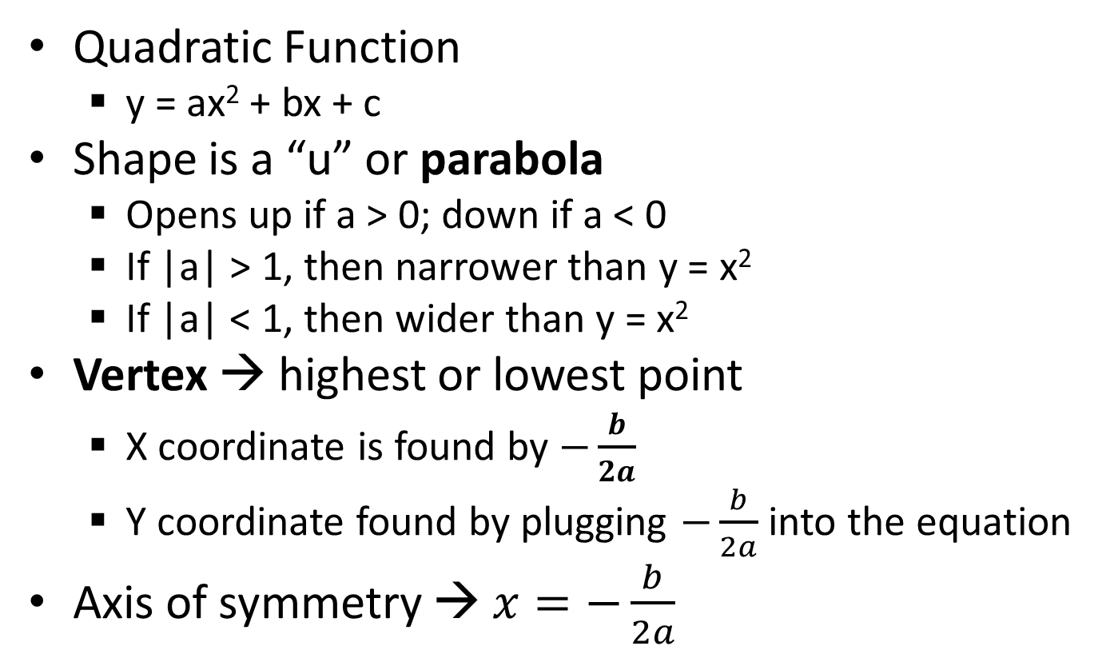
4.1 Graph quadratic Functions in Standard Form
Quadratic Function
  y = ax² + bx + c
Shape is a “u” or parabola
  Opens up if a > 0; down if a < 0
  If |a| > 1, then narrower than y = x²
  If |a| < 1, then wider than y = x²
Vertex → highest or lowest point
  X coordinate is found by $−\frac{b}{2a}$
  Y coordinate found by plugging $−\frac{b}{2a}$ into the equation
Axis of symmetry → $x=−\frac{b}{2a}$

Slide 9
4.1 Graph quadratic Functions in Standard Form
How to Graph (Standard Form)
  Find and plot the vertex
  Make a table around the vertex
  Draw the curve through all 5 points

Slide 10
4.1 Graph quadratic Functions in Standard Form
Graph y = -x² + 2x
Graph y = 2x² + 6x + 3
Notes:
Vertex at (1, 1) → other points (-2, -8), (-1, -3), (0, 0), (2, 0), (3, -3)
Vertex at (-1.5, -1.5) → other points (-3, 3), (-2, -1), (-1, -1), (0, 3), (1, 11)

Slide 11
4.1 Graph quadratic Functions in Standard Form
Find the minimum value of y = 4x² + 16x – 3
Notes:
Minimum occurs at vertex: x = -b/2a → x = -16/(2∙4) = -2
y = 4(-2)² + 16(-2) – 3 = -19
The minimum value is -19

Slide 12
4.1 Graph quadratic Functions in Standard Form
A video store sells about 150 DVDs a week for $20 each. The owner estimates that for each $1 decrease in price, about 25 more DVDs will be sold each week. How can the owner maximize weekly revenue?
Notes:
Revenue is how much money comes in.
Revenue = Price ∙ Number sold
R = (20 – x)(150 + 25x) = 3000 + 500x – 150x – 25x²
R = -25x² + 350x + 3000
Maximum occurs at vertex
x = -350/(2(-25)) = 7
y = -25(7)² + 350(7) + 3000 = 4225
The owner should drop the price $7 making the revenue $4225

Slide 13
4.1 Graph quadratic Functions in Standard Form
240 #1-57 every other odd + 5 choice = 20

Slide 14
Homework Quiz
4.1 Homework Quiz

Slide 15
4.2 Graph Quadratic Functions in Vertex or Intercept Form
Vertex Form
  y = a(x – h)² + k
  (h, k) is vertex
  x = h is axis of symmetry
(h, k) is the vertex because, if h and k = 0, then y = ax²
  The vertex of this is zero (from yesterday)
  We learned before that
    h is how far the graph moves right
    k is how far the graph moves up
Graph same way as before

Slide 16
4.2 Graph Quadratic Functions in Vertex or Intercept Form
Graph y = 2(x – 1)² + 3
Notes:
Vertex at (1, 3)→ other points (2, 5), (0, 5), (3, 11), (-1, 11)

Slide 17
4.2 Graph Quadratic Functions in Vertex or Intercept Form
Intercept Form
  y = a(x – p)(x – q)
  x-intercepts are p and q
  axis of symmetry is halfway between p and q
Graph the intercepts and find the axis of symmetry.
  Vertex → x coordinate is axis of symmetry, plug in to equation to find y-value

Slide 18
4.2 Graph Quadratic Functions in Vertex or Intercept Form
Graph y = (x – 3)(x + 1)
Notes:
Vertex at (1, -4) → x-int at (3, 0) and (-1, 0)

Slide 19
4.2 Graph Quadratic Functions in Vertex or Intercept Form
If an object is propelled straight upward from Earth at an initial velocity of 80 feet per second, its height after t seconds is given by h(t) = -16t(t – 5).
  How many seconds after it is propelled will the object hit the ground?
  What is the object’s maximum height?
Notes:
This is in intercept form y = -16(t – 0)(t – 5)
Thus it will be at zero height when either (t – 0) = 0 or (t – 5) = 0. t – 5 = 0 → t = 5 seconds
Maximum height occurs at the vertex: intercepts are 0 and 5, so vertex is at t = 2.5
h(2.5) = -16(2.5)(2.5 – 5) = 100 feet

Slide 20
4.2 Graph Quadratic Functions in Vertex or Intercept Form
FOIL
To multiply (x + 2)(x – 3)
  First → x·x
  Outer → -3x
  Inner → 2x
  Last → 2·-3 = -6
  Add together → x² – x – 6
To multiply (x – 2)²
  (x – 2)(x – 2)
  FOIL
  x² – 4x + 4

Slide 21
4.2 Graph Quadratic Functions in Vertex or Intercept Form
Write the quadratic function in standard form
  y = -(x – 2)(x – 7)
f(x) = -(x + 2)² + 4
249 #1-53 every other odd + 1 choice = 15
Notes:
y = -(x – 2)(x – 7) → y = -(x² – 7x – 2x + 14) → y = -(x² – 9x + 14) → y = -x² + 9x – 14
f(x) = -(x + 2)² + 4 → f(x) = -(x + 2)(x + 2) + 4 → f(x) = -(x² + 2x + 2x + 4) + 4 → f(x) = -(x² + 4x + 4) + 4 → f(x) = -x² – 4x – 4 + 4 → f(x) = -x² – 4x

Slide 22
Homework Quiz
4.2 Homework Quiz

Slide 23
4.3 Solve x² + bx + c = 0 by Factoring
Factoring is the opposite of FOILing
Factoring undoes multiplication
(x + 2)(x + 5) = x² + 7x + 10
  x + 2 called binomial
  x² + 7x + 10 called trinomial

Slide 24
4.3 Solve x² + bx + c = 0 by Factoring
Factoring trinomial
  ax² + bx + c
Write two sets of parentheses ( )( )
Guess and Check
The Firsts multiply to make ax²
The Lasts multiply to make c
Check to make sure the Outers + Inners make bx

Slide 25
4.3 Solve x² + bx + c = 0 by Factoring
Factor the expression
  x² – 3x – 18
  n² – 3n + 9
  r² + 2r – 63
Notes:
(x – 6)(x + 3)
Cannot be factored
(r + 9)(r – 7)

Slide 26
4.3 Solve x² + bx + c = 0 by Factoring
Special patterns
  Difference of Squares
    a² – b² = (a – b)(a + b)
  Perfect Squares
    a² ± 2ab + b² = (a ± b)²
Factor
  x² – 9
  w² – 18w + 81
Notes:
Difference of Squares: x² – 9 = (x – 3)(x + 3)
Perfect Squares: w² – 18w + 81 = (w – 9)²

Slide 27
4.3 Solve x² + bx + c = 0 by Factoring
Solving quadratic equations by factoring
  The solutions to quadratic equation are called zeros
Zero Product Property
  Zero times anything = 0
  If ab = 0, then a = 0, b = 0, or both.
  Thus we can factor a quadratic equation (remember factoring gives you at least two pieces multiplied together) and set each factor equal to zero to solve.
Example:
  Solve (3y – 5)(2y + 7) = 0
Notes:
ANS: take each factor = 0
3y – 5 = 0 → 3y = 5 → y = 5/3
2y + 7 = 0 → 2y = -7 → y = -7/2

Slide 28
4.3 Solve x² + bx + c = 0 by Factoring
Solve
  x² – x – 42 = 0
  x² – 8x + 16 = 0
Notes:
x² – x – 42 = 0 → (x – 7)(x + 6) = 0 →
x – 7 = 0 → x = 7
x + 6 = 0 → x = -6
Solutions are x = -6, 7
x² – 8x + 16 = 0 → (x – 4)(x – 4) = 0 →
x – 4 = 0 → x = 4
Solutions are x = 4

Slide 29
4.3 Solve x² + bx + c = 0 by Factoring
Finding Zeros
  Zeros are the values of x when y = 0
    Also called x-intercepts or roots
  When you find zeros make y = 0 and solve
  Find the zeros of y = x² – 7x – 30 by rewriting the function in intercept form.
Notes:
y = x² – 7x – 30 → y = (x – 10)(x + 3)
Zeros are -3, 10

Slide 30
4.3 Solve x² + bx + c = 0 by Factoring
255 #1-21 every other odd, 27-59 every other odd, 65 + 4 choice = 20

Slide 31
Homework Quiz
4.3 Homework Quiz

Slide 32
4.4 Solve ax² + bx + c = 0 by Factoring
Very similar to yesterday’s lesson
Two differences
  Factor monomial first
  Make a work just like c

Slide 33
4.4 Solve ax² + bx + c = 0 by Factoring
Monomial First
  Factor out any common terms first, then factor what’s left
14x² + 2x – 12
3x² – 18x
Notes:
2(7x² + x – 6) → 2(7x – 6)(x + 1)
3x(x – 6)

Slide 34
4.4 Solve ax² + bx + c = 0 by Factoring
Factor
  12x² + 3x + 3
  2x² – 32
Notes:
3(4x² + x + 1)
2(x² – 16) → 2(x – 4)(x + 4)

Slide 35
4.4 Solve ax² + bx + c = 0 by Factoring
Solve
  9t² – 12t + 4 = 0
  3x – 6 = x² – 10
Notes:
ANS: (3t – 2)² = 0 → 3t – 2 = 0 → 3t = 2 → t = 2/3
ANS: Put in standard form
x² – 3x – 4 = 0
(x – 4)(x + 1) = 0
x – 4 = 0 → x = 4
x + 1 = 0 → x = -1

Slide 36
4.4 Solve ax² + bx + c = 0 by Factoring
You are designing a garden. You want the garden to be made up of a rectangular flower bed surrounded by a border of uniform width to be covered with decorative stones. You have decided that the flower bed will be 22 feet by 15 feet, and your budget will allow for enough stone to cover 120 square feet. What should be the width of the border?
22
x
15
x
Notes:
Outer rectangle area – inner rectangle area = 120
(2x + 22)(2x + 15) – (22)(15) = 120
4x² + 30x + 44x + 330 – 330 = 120
4x² + 74x = 120
4x² + 74x – 120 = 0
Divide by 2: 2x² + 37x – 60 = 0
Factor: (2x – 3)(x + 20) = 0
2x – 3 = 0 → 2x = 3 → x = 3/2
x + 20 = 0 → x = -20 can’t use negative numbers
Border is 3/2 feet or 1.5 feet or 18 inches

Slide 37
4.4 Solve ax² + bx + c = 0 by Factoring
263 #3-27 every other odd, 31-47 odd, 51, 55, 59, 65 + 5 choice = 25

Slide 38
Homework Quiz
4.4 Homework Quiz

Slide 39
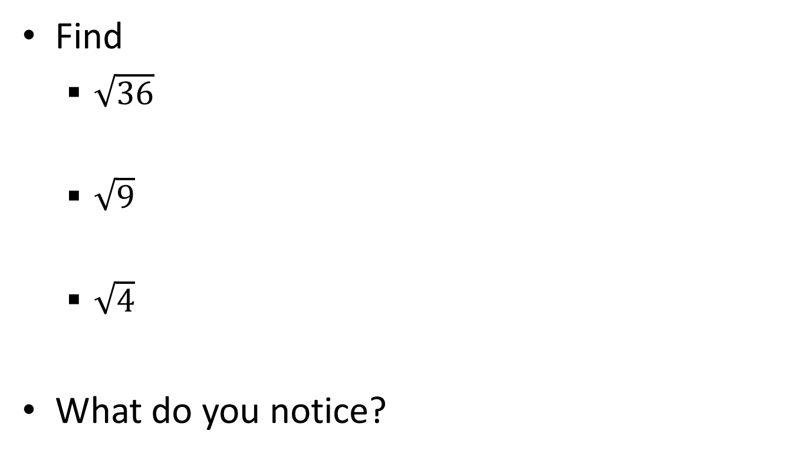
4.5 Solve Quadratic Equations by Finding Square Roots
Find
  $\sqrt{36}$
  $\sqrt{9}$
  $\sqrt{4}$
What do you notice?
Notes:
√36 = √9√4

Slide 40
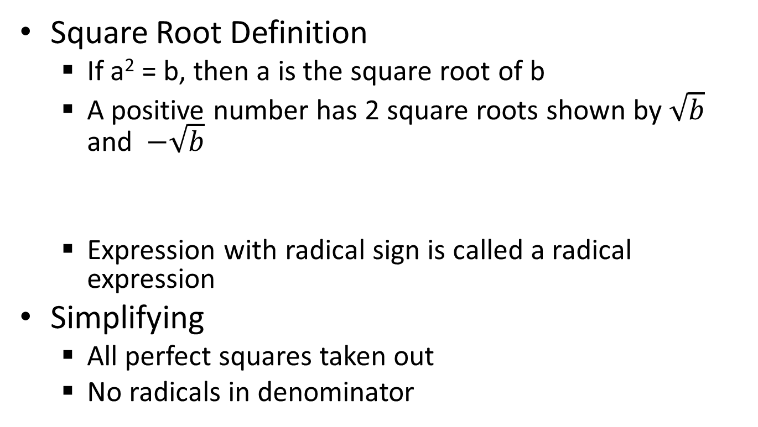

4.5 Solve Quadratic Equations by Finding Square Roots
Square Root Definition
  If a² = b, then a is the square root of b
  A positive number has 2 square roots shown by $\sqrt{b}$ and $−\sqrt{b}$
  Expression with radical sign is called a radical expression
Simplifying
  All perfect squares taken out
  No radicals in denominator
$$\sqrt{36}$$
radical sign
radicand
Notes:
The term radical comes from Latin “radix” which means “root”. Other terms with same root: “Radish”, “eradicate” (pull out be roots)

Slide 41
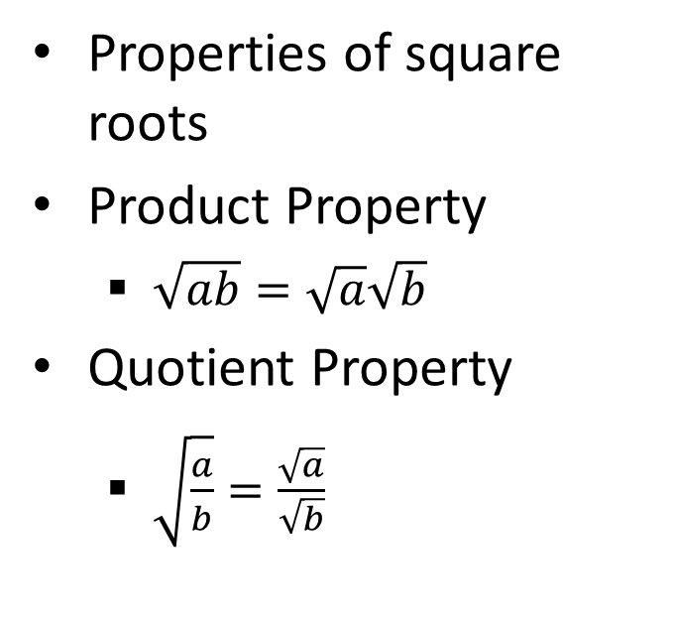
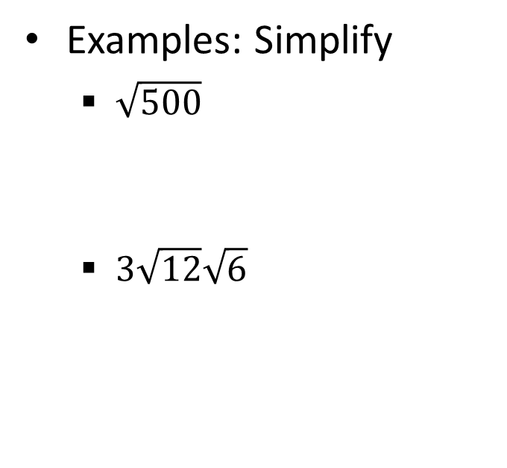
4.5 Solve Quadratic Equations by Finding Square Roots
Properties of square roots
Product Property
  $\sqrt{ab}=\sqrt{a}\sqrt{b}$
Quotient Property
  $\sqrt{\frac{a}{b}}=\frac{\sqrt{a}}{\sqrt{b}}$
Examples: Simplify
  $\sqrt{500}$
  $3\sqrt{12}\sqrt{6}$
Notes:
√5 √100 → 10√5
3√72 → 3√36 √2 → (3)(6)√2 → 18√2

Slide 42


4.5 Solve Quadratic Equations by Finding Square Roots
Simplify
  $\sqrt{\frac{25}{3}}$
$\frac{5}{2+\sqrt{3}}$
Notes:
√25 / √3 → 5 / √3 → 5√3 / (√3 √3) → 5√3 / 3
$\frac{5}{2+\sqrt{3}}$ = $\frac{5\left(2−\sqrt{3}\right)}{\left(2+\sqrt{3}\right)\left(2−\sqrt{3}\right)}=\frac{10−5\sqrt{3}}{4−3}=10−5\sqrt{3}$

Slide 43
4.5 Solve Quadratic Equations by Finding Square Roots
Solving Quadratic Equations by finding square roots
  When? Only 1 term with x and it is squared
  Isolate the square and then take the ±√
Solve
  3 – 5x² = -9
269 #1-39 odd + 5 choice = 25
  3(x – 2)² = 21
Notes:
ANS: -5x² = -12 → x² = 12/5 → x = ±√(12/5) → x = ±√12/√5 → x=±2√3 √5 / √5 √5 → x = ±2√15 / 5
ANS: (x – 2)² = 7 → x – 2 = ±√7 → x = 2 ± √7

Slide 44
Homework Quiz
4.5 Homework Quiz

Slide 45
4.6 Perform Operations with Complex Numbers
When we were young we learned to count.
Then as we got older we learned to operate with combining those counting numbers.
Next we learned about negative numbers and fractions. With this came more rules for the operations.
Finally we are going to learn about complex numbers and the rules for dealing with them.

Slide 46
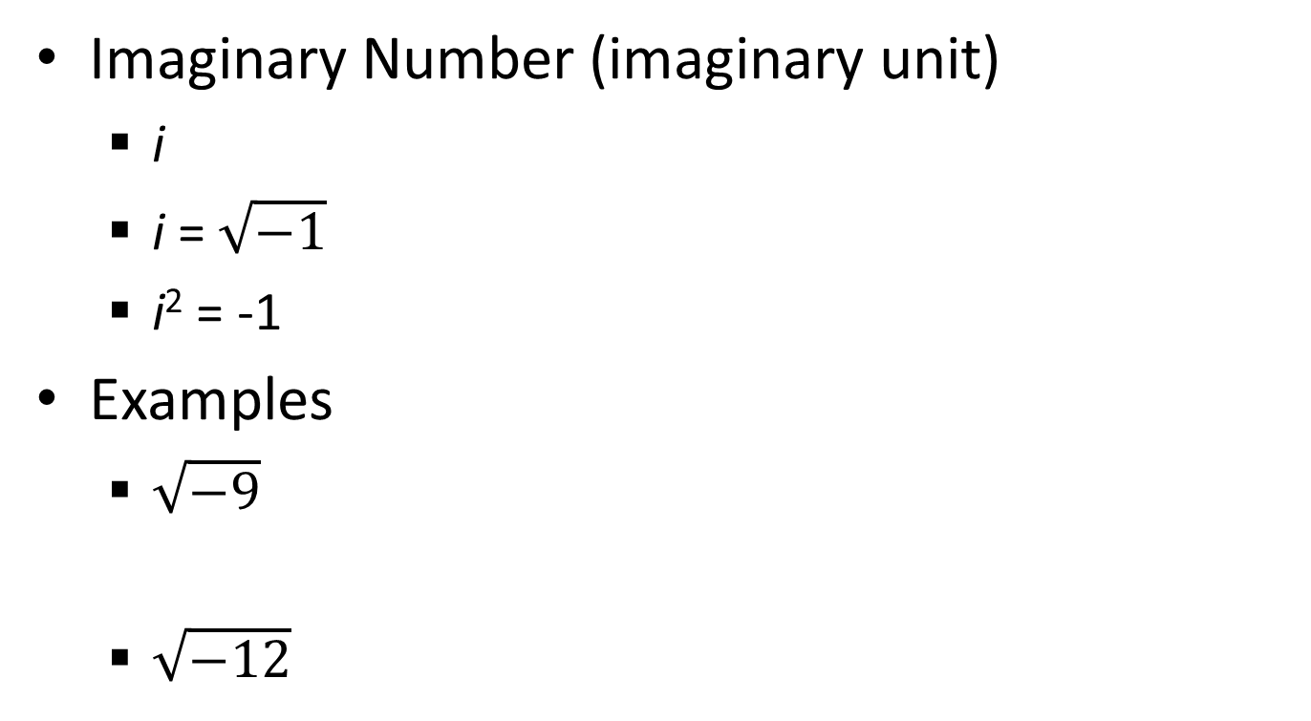
4.6 Perform Operations with Complex Numbers
Imaginary Number (imaginary unit)
  i
  i = $\sqrt{−1}$
  i² = -1
Examples
  $\sqrt{−9}$
  $\sqrt{−12}$
Notes:
3i
i√4√3 → 2i√3

Slide 47
4.6 Perform Operations with Complex Numbers
Complex Number
  Includes real numbers and imaginary numbers
Imaginary numbers are any number with i
  (a + bi) where a and b are real
Plotting
  Complex plane → x-axis is the real axis; y-axis is the imaginary axis
Examples: plot
  -4-i
  5
  1 + 3i

Slide 48
4.6 Perform Operations with Complex Numbers
Adding and Subtracting Complex Numbers
  Add the same way you add (x + 4) + (2x – 3) = 3x+1
  Combine like terms
Examples: simplify
  (-1 + 2i) + (3 + 3i)
  (2 – 3i) – (3 – 7i)
  2i – (3 + i) + (2 – 3i)
Notes:
2 + 5i
-1 + 4i
-1

Slide 49
4.6 Perform Operations with Complex Numbers
Multiplying complex numbers
  FOIL
  Remember i² = -1
Examples: multiply
  –i(3 + i)
  (2 + 3i)(-6 – 2i)
  (1 + 2i)(1 – 2i)
Notes:
-3i – i² = 1 – 3i
-12 – 4i – 18i – 6i² = -6 – 22i
1 – 2i + 2i – 4i² = 5

Slide 50
4.6 Perform Operations with Complex Numbers
  Notice on the last example that the answer was just real
Complex conjugate → same numbers just opposite sign on the imaginary part
  When you multiply complex conjugates, the product is real
Dividing Complex Numbers
  To divide, multiply the numerator and denominator by the complex conjugate of the denominator
  No imaginary numbers are allowed in the denominator when simplified

Slide 51
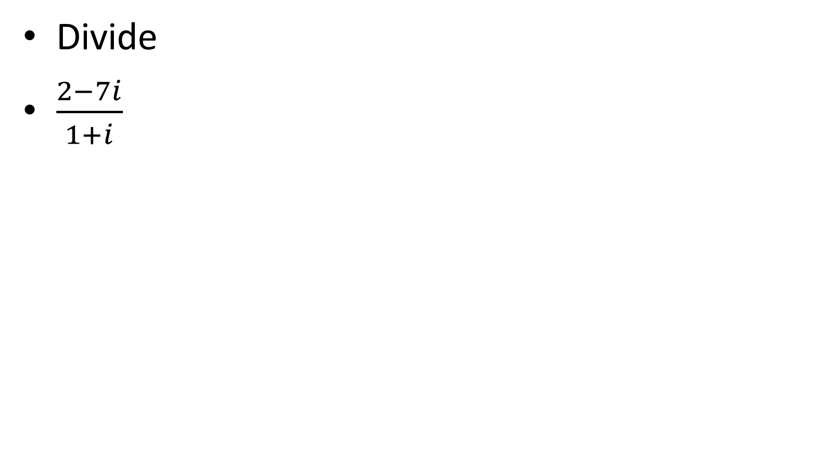
4.6 Perform Operations with Complex Numbers
Divide
$\frac{2−7i}{1+i}$
Notes:
(-5-9i)/2

Slide 52
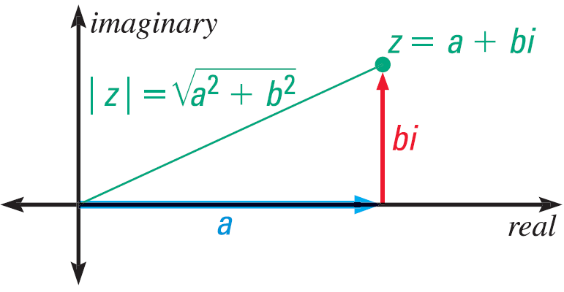
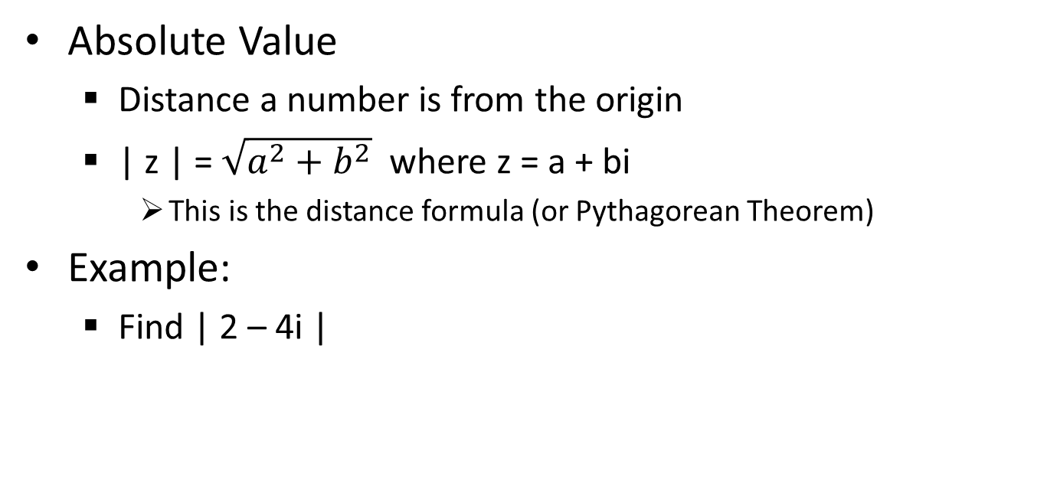
4.6 Perform Operations with Complex Numbers
Absolute Value
  Distance a number is from the origin
  | z | = $\sqrt{a^{2}+b^{2}}$ where z = a + bi
    This is the distance formula (or Pythagorean Theorem)
Example:
  Find | 2 – 4i |
Notes:
√(2² + (-4)²) = √(4 + 16) = √20 = 2√5

Slide 53
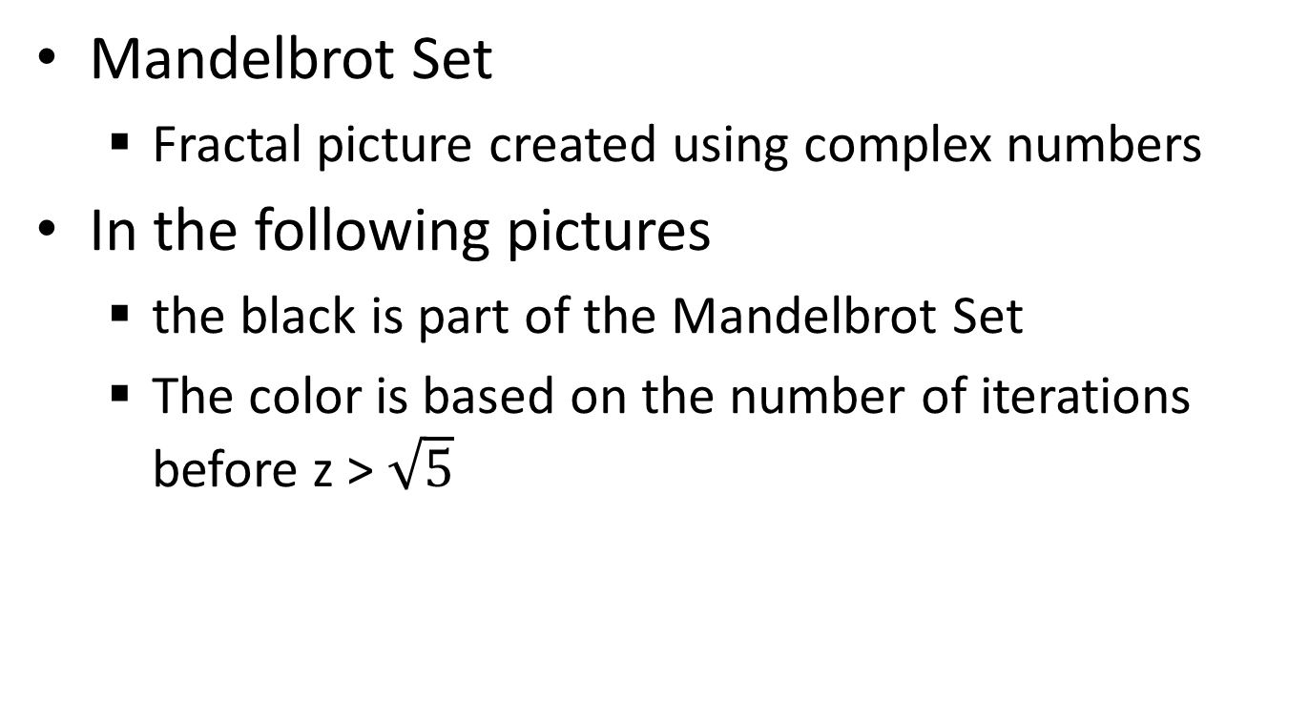
4.6 Perform Operations with Complex Numbers
Mandelbrot Set
  Fractal picture created using complex numbers
In the following pictures
  the black is part of the Mandelbrot Set
  The color is based on the number of iterations before z > $\sqrt{5}$
Notes:
We’ll find out about z later

Slide 54

Notes:
Black is part of the set
Color indicates how many iterations were required before z became larger than √5

Slide 55


Slide 56


Slide 57


Slide 58


Slide 59


Slide 60


Slide 61
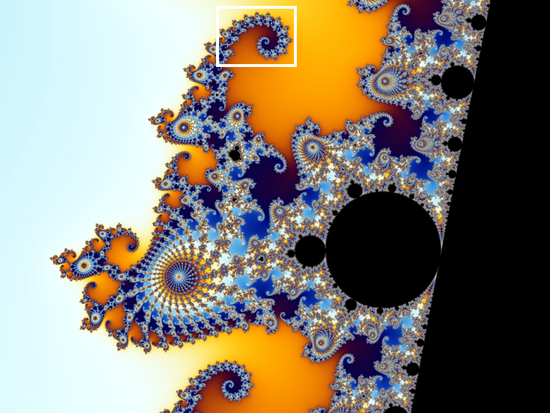

Slide 62


Slide 63
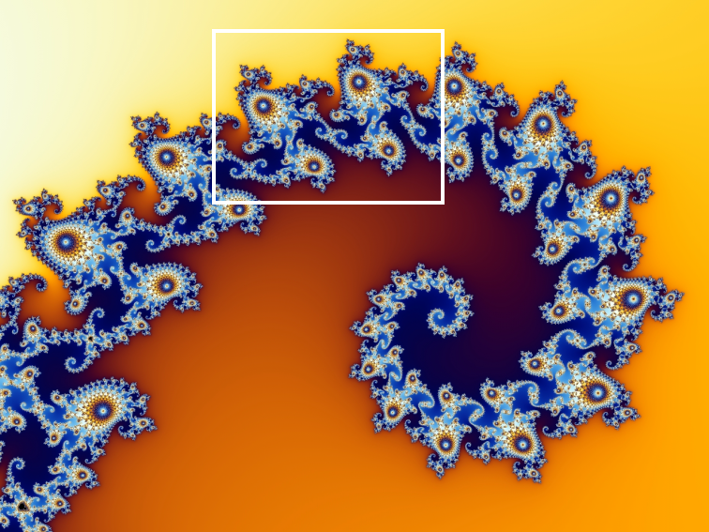

Slide 64


Slide 65
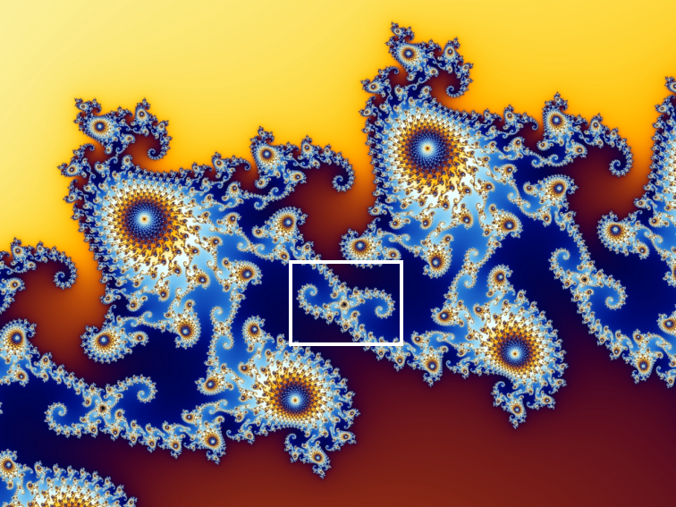

Slide 66


Slide 67


Slide 68


Slide 69


Slide 70


Slide 71


Slide 72


Slide 73
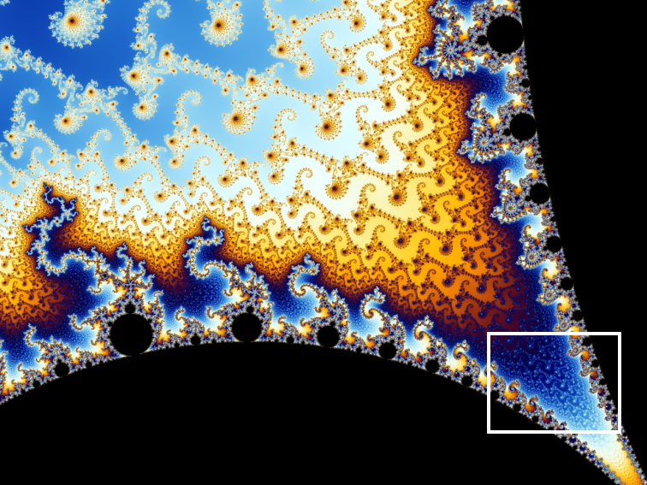

Slide 74


Slide 75


Slide 76


Slide 77


Slide 78


Slide 79


Slide 80


Slide 81


Slide 82


Slide 83
4.6 Perform Operations with Complex Numbers
Solve the quadratic equation
  x² – 8 = -36
279 #1, 3-75 every other odd + 5 choice = 25
Notes:
x² – 8 = -36
x² = -28
x = ±√-28 = ±i√28 = ±i√4√7 = ±2i√7

Slide 84
Homework Quiz
4.6 Homework Quiz

Slide 85
4.7 Complete the Square
The Perfect Square
(x + 3)²
(x + k)² = x² + 2kx + k²
Notes:
=(x + 3)(x + 3)
= x² + 2(3x) + 32
= x² + 6x + 9

Slide 86
4.7 Complete the Square
What should c be to make a perfect square
  x² + 8x + c
Notes:
you have to add (8/2)² = 42 = 16 to get a perfect square or (x + 4)²

Slide 87
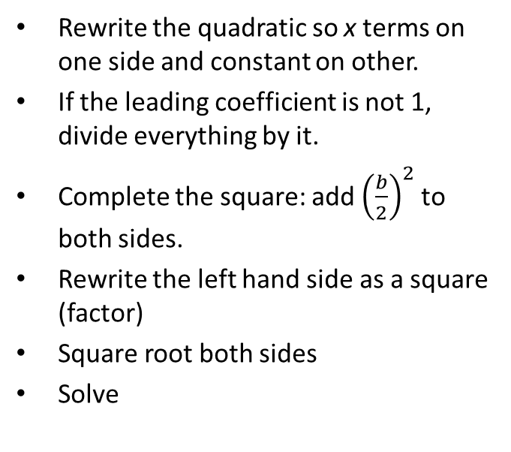
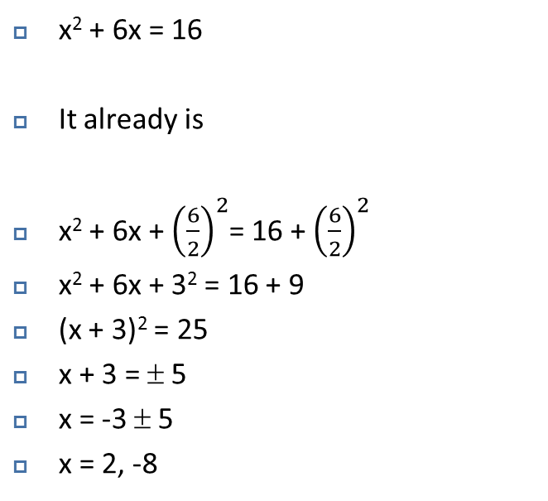
4.7 Complete the Square
Rewrite the quadratic so x terms on one side and constant on other.
If the leading coefficient is not 1, divide everything by it.
Complete the square: add ${\left(\frac{b}{2}\right)}^{2}$ to both sides.
Rewrite the left hand side as a square (factor)
Square root both sides
Solve
  x² + 6x = 16
  It already is
  x² + 6x + ${\left(\frac{6}{2}\right)}^{2}$= 16 + ${\left(\frac{6}{2}\right)}^{2}$
  x² + 6x + 3² = 16 + 9
  (x + 3)² = 25
  x + 3 = ± 5
  x = -3 ± 5
  x = 2, -8

Slide 88
4.7 Complete the Square
Solve 2x² – 11x + 12 = 0
Notes:
ANS: 2x² – 11x = -12
x² – 11/2 x = -6
x² – 11/2 x + (-11/2/2)² = -6 + (-11/2/2)² → (-11/2/2)² = (-11/4)² =121/16
(x – 11/4)² = 25/16
x – 11/4 = ± 5/ 4
x = 11/4 ±5/ 4 = (11±5)/4 = 4, 3/2

Slide 89
4.7 Complete the Square
The area of the rectangle is 56. Find the value of x.
2x + 3
4x
Notes:
4x(2x + 3) = 56
8x² + 12x = 56
x² + 3/2 x = 7
x² + 3/2 x + (3/4)² = 7 + 9/16
(x + ¾)² = 121/16
x + ¾ = ±√(121/16)
x + ¾ = ±11/4
x = -3/4 ± 11/4
x = 8/4 = 2 and 14/4 = 7/2

Slide 90
4.7 Complete the Square
Writing quadratic functions in Vertex Form
y = a(x – h)² + k
  (h, k) is the vertex
Start with standard form
Group the terms with the x
Factor out any number in front of the x²
Add (b/2)² to both sides (inside the group on the right)
Rewrite as a perfect square
Subtract to get the y by itself
  y = 2x² + 12x + 16
  y = (2x² + 12x) + 16
  y = 2(x² + 6x) + 16
  y + 2(9) = 2(x² + 6x + 9) + 16
  y + 18 = 2(x + 3)² + 16
  y = 2(x + 3)² – 2
  Vertex is at (-3, -2)
  -2 is the minimum for this function
  Find the max or min by completing the square to find the vertex

Slide 91
4.7 Complete the Square
288 #3-55 every other odd, 61, 65 + 4 choice = 20

Slide 92
Homework Quiz
4.7 Homework Quiz

Slide 93
4.8 Use the Quadratic Formula and the Discriminant
Completing the square was a long laborious process. Today we can develop a method to make it quicker.

Slide 94
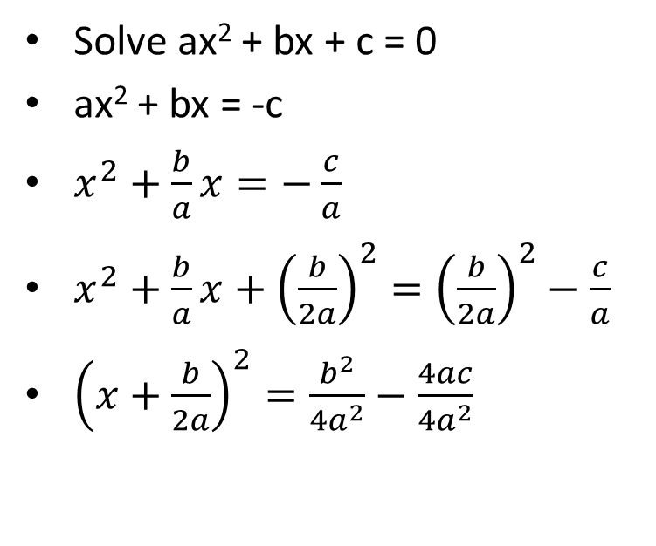
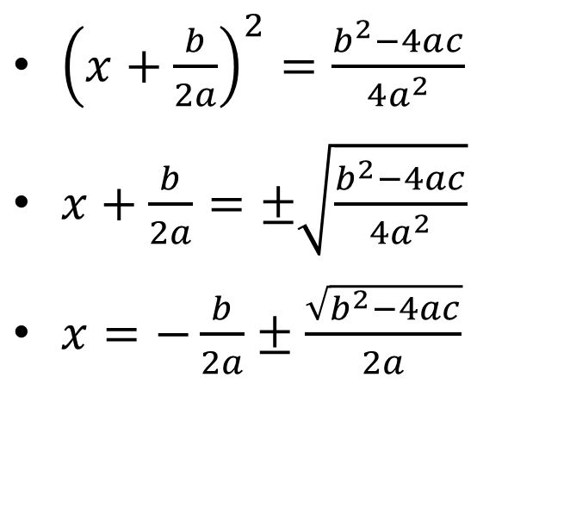
4.8 Use the Quadratic Formula and the Discriminant
Solve ax² + bx + c = 0
ax² + bx = -c
$x^{2}+\frac{b}{a}x=−\frac{c}{a}$
$x^{2}+\frac{b}{a}x+{\left(\frac{b}{2a}\right)}^{2}={\left(\frac{b}{2a}\right)}^{2}−\frac{c}{a}$
${\left(x+\frac{b}{2a}\right)}^{2}=\frac{b^{2}}{4a^{2}}−\frac{4ac}{4a^{2}}$
${\left(x+\frac{b}{2a}\right)}^{2}=\frac{b^{2}−4ac}{4a^{2}}$
$x+\frac{b}{2a}=±\sqrt{\frac{b^{2}−4ac}{4a^{2}}}$
$x=−\frac{b}{2a}±\frac{\sqrt{b^{2}−4ac}}{2a}$
Notes:
2x² + 6x – 4 = 0 ax² + bx + c = 0
x² + 3x – 2 = 0 Divide by 2 to get a = 1 x² + (b/a)x + (c/a) = 0
x² + 3x = 2 Add two to get x’s by self x² + (b/a)x = -(c/a)
x² + 3x + (3/2)² = 2 + (3/2)² Add the square of half of middle to get perfect square x² + (b/a)x + (b/2a)² = -(c/a) + (b/2a)²
(x + 3/2)² = 2 + 9/4 Factor left (x + (b/2a))² = -c/a + b²/4a²
x + 3/2 = ±√(17/4) Square root x + (b/2a) = ±√((-4ac+b²)/(4a²))
x = -3/2 ±√(17/4) Subtract x = -b/2a ±√((b²-4ac)/(4a²))
x = (-3±√17)/2 Simplify x = (-b±√(b²-4ac))/2a

Slide 95
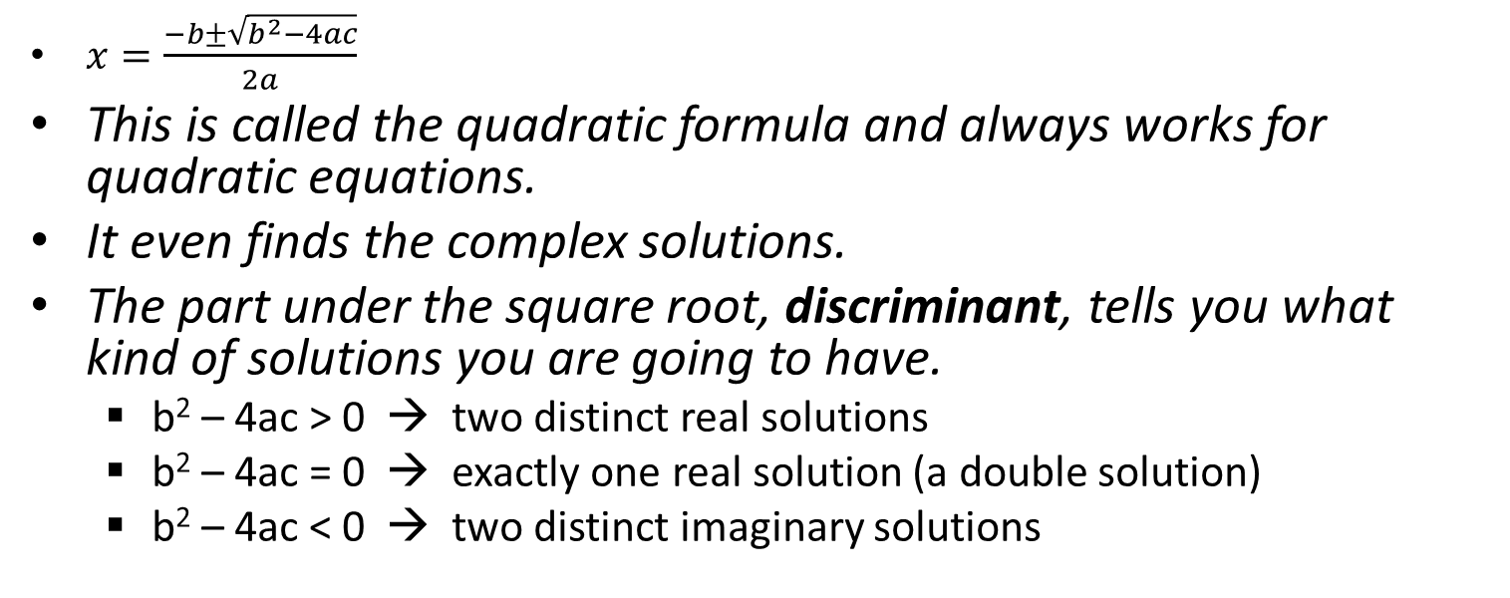
4.8 Use the Quadratic Formula and the Discriminant
$x=\frac{−b±\sqrt{b^{2}−4ac}}{2a}$
This is called the quadratic formula and always works for quadratic equations.
It even finds the complex solutions.
The part under the square root, discriminant, tells you what kind of solutions you are going to have.
  b² – 4ac > 0 → two distinct real solutions
  b² – 4ac = 0 → exactly one real solution (a double solution)
  b² – 4ac < 0 → two distinct imaginary solutions

Slide 96
4.8 Use the Quadratic Formula and the Discriminant
What types of solutions to 5x² + 3x – 4 = 0?
Solve 5x² + 3x = 4
Notes:
3² – 4(5)(-4) = 9 + 80 = 89 → two distinct real roots
Put in standard form → 5x² + 3x – 4 = 0
Quadratic formula → x = (-3±√(3²-4(5)(-4)))/(2(5))
Simplify → (-3±√(89))/10

Slide 97

4.8 Use the Quadratic Formula and the Discriminant
Solve $4x^{2}−6x+3=0$
296 #1-73 every other odd + 6 choice = 25
Notes:
$$4x^{2}−6x+3=0$$
$$x=\frac{6±\sqrt{{\left(−6\right)}^{2}−4\left(4\right)\left(3\right)}}{2\left(4\right)}$$
$$x=\frac{6±\sqrt{36−48}}{8}$$
$$x=\frac{6±\sqrt{−12}}{8}$$
$$x=\frac{6±2\sqrt{3}i}{8}$$
$$x=\frac{3±\sqrt{3}i}{4} (reduce top and bottom by 2)$$

Slide 98
Homework Quiz
4.8 Homework Quiz

Slide 99
4.9 Graph and Solve Quadratic Inequalities
Often in real-life, what we are looking for is a range instead of just one value.
An example is how many tickets must be purchased to make at least $500?
That means real-life often uses inequalities.

Slide 100
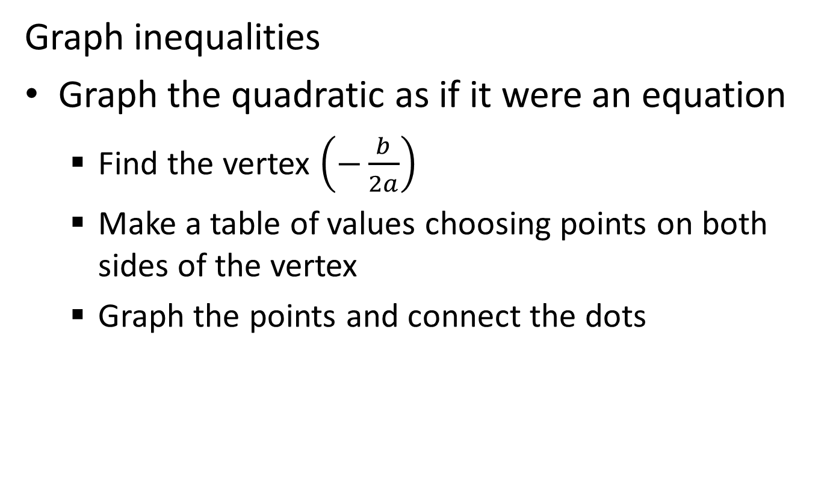
4.9 Graph and Solve Quadratic Inequalities
Graph inequalities
Graph the quadratic as if it were an equation
  Find the vertex $\left(−\frac{b}{2a}\right)$
  Make a table of values choosing points on both sides of the vertex
  Graph the points and connect the dots

Slide 101
4.9 Graph and Solve Quadratic Inequalities
Dotted line or solid line
Shade
  Pick a test point (not on the line)
  Try plugging it in the inequality
  If you get a true statement shade that side of the line
  If you get a false statement shade the other side of the line.

Slide 102
4.9 Graph and Solve Quadratic Inequalities
Graph y ≥ x² – 10x + 25
Notes:
ANS: Vertex at x = 10/2 = 5
Table of values to include x = {1, 2, 3, 4, 5, 6, 7, 8, 9}
Pick (0, 0) as test point → 0 ≥ 25 false shade other side of line.

Slide 103
4.9 Graph and Solve Quadratic Inequalities
Solve inequalities in one variable.
Make = 0
Factor or use the quadratic formula to find the zeros
Graph the zeros on a number line (notice it cuts the line into three parts)
Pick a number in each of the three parts as test points
Test the points in the original inequality to see true or false
Write inequalities for the regions that were true
p² – 4p ≤ 5
p² – 4p – 5 ≤ 0
(p – 5)(p + 1) ≤ 0
  Zeros are 5, -1
test points = -2, 0, 6
  –2 → 4 – 4(-2) ≤ 5 → 12 ≤ 5 false
  0 → 0 – 4(0) ≤ 5 → 0 ≤ 5 true
  6 → 36 – 4(6) ≤ 5 → 12 ≤ 5 false
middle region true so –1 ≤ p ≤ 5
0

Slide 104
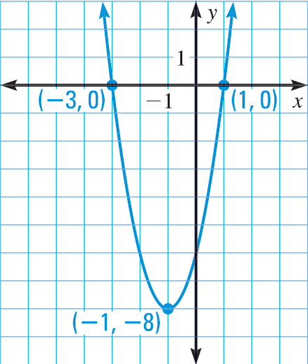
4.9 Graph and Solve Quadratic Inequalities
Or You could also solve the quadratic inequality in one variable by graphing the quadratic
  Make the equation = 0
  Graph
  When the graph is below
  the x-axis; ≤ 0
  When the graph is above
  the x-axis; ≥ 0
Notes:
2x² + 4x – 6 ≤ 0 when -3 ≤ x ≤ 1
2x² + 4x – 6 ≥ 0 when x ≤ -3 or x ≥ 1

Slide 105
4.9 Graph and Solve Quadratic Inequalities
304 #3-75 every other odd + 6 choice = 25

Slide 106
Homework Quiz
4.9 Homework Quiz

Slide 107
4.10 Write Quadratic Functions and Models
We can easily find the equations of lines (y = mx + b), but curves are a little more tricky.
Today we will learn how to fit a quadratic function to some given points.

Slide 108
4.10 Write Quadratic Functions and Models
Vertex Form → given vertex and one other point
  Fill in the vertex y = a(x – h)² + k
  Plug in your other point and find a
  Write the equation
Example: vertex at (-2, 1), point at (1, -1)
Notes:
ANS: y = a(x + 2)² + 1 → -1 = a(1 + 2)² + 1 → -1 = 9a + 1 → -2 = 9a → a = -2/9 → y = -2/9 (x + 2)² + 1

Slide 109
4.10 Write Quadratic Functions and Models
Intercept Form → given the x-intercepts and one other point
  Fill in y = a(x – p)(x – q) with the intercepts (p and q)
  Plug in your other point and find a
  Write the equation
Example: x-ints of 1 and 4, point at (2, -6)
Notes:
ANS: y = a(x – 1)(x – 4) → -6 = a(2 – 1)(2 – 4) → -6 = a(1)(-2) → a = 3 → y = 3(x – 1)(x – 4)

Slide 110
4.10 Write Quadratic Functions and Models
Standard Form → any 3 points
  Use one of the above two and simplify OR
  Fill in the x and y of ax² + bx + c = y with each of the three points creating a system of three equations with the variables of a, b, and c
  Solve the system
  Write your equation

Slide 111
4.10 Write Quadratic Functions and Models
Example: points (-2, -1), (1, 11), (2, 27)
Notes:
Use Cramer's rule y = 3x² + 7x + 1

Slide 112
4.10 Write Quadratic Functions and Models
Best-Fitting Quadratic Regression
  (Graphing Calculators)
  Gives the best-fitting quadratic model for a given set of at least 3 data points
Steps
  Push STAT
  Select Edit…
  Enter x values in L1 and y values in L2
  Push STAT
  Select CALC → QuadReg
  Push Enter again

Slide 113
4.10 Write Quadratic Functions and Models
312 #3-39 every other odd, 47, 51 + 3 choice = 15

Slide 114
Homework Quiz
4.10 Homework Quiz

Slide 115
4.Review
323 # 20 choice = 20

